Slide 1
Assembly Language
Lab 7
2022/10/31

Slide 2
Objectives
Add a MACRO named divide to the program. After the program calls divide, four parameters are passed in. Perform a division operation and return the quotient and remainder remaining.
.data
dividend WORD _____________;The last 4 digit of the group leader's student id(decimal)
divisor WORD 100
quotient WORD 1 DUP(?)
remainder WORD 1 DUP(?)

Slide 3
Objectives
.code
main PROC
movsx eax, dividend
call WriteDec
call Crlf
divide dividend, divisor, quotient, remainder
movsx eax, quotient
call WriteDec
call Crlf
movsx eax, remainder
call WriteDec
call Crlf
main ENDP
END main

Slide 4
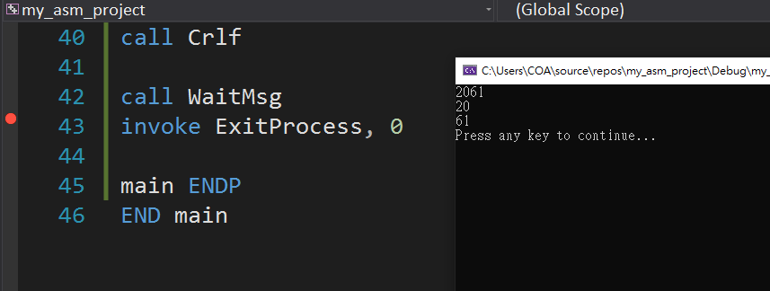
Result

Slide 5
Report
Due Date (2022/11/1)
Before 12:00
If you submit late, please send a letter to the teaching assistant, points will be deducted
Group Task
Compress(.zip,.rar) the following file with the name of the group ( e.g. lab7_01.zip)
Code(lab7_01.asm)
Report(lab7_01.doc or lab7_01.pdf)
Report Title
Group, name, student ID
Step by step of program execution flow, memory (register) status
Screenshots description, code Description
Reviews for the class, lesson learned, the tools we used, TA, etc

Slide 6
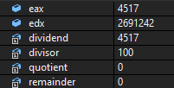
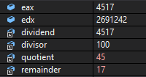
Before call divide
After

